Slide 1

DATA VISUALIZATION FOR DEEPAWALI SALES DATASET
TEAM MEMBERS:
BELLAKKI VINAYAK - (20201ISE0038)
SUHAS N - (20201ISB0025)
KOUSHIK G - (20201ISE0024)

Slide 2

ABSTRACT
The festival of Deepawali, celebrated with great enthusiasm in India, brings a significant surge in consumer purchases. This makes it a critical period for businesses to maximize sales and enhance customer satisfaction. This project aims to leverage Python programming for exploratory data analysis on parameters such as gender, age, location, marital status, occupation, and product categories during Deepawali. The analysis aims to provide valuable insights that can help businesses improve their customer experience and boost sales.

Slide 3
INTRODUCTION
This project uses Python to analyze Diwali sales data in India, aiming to improve customer experience and sales. The process includes data collection, preprocessing, trend analysis, customer segmentation, product evaluation, sentiment analysis, and predictive modeling. The goal is to help businesses understand their customers better, optimize product offerings, and develop targeted marketing strategies. This project provides practical experience in applying data science techniques for beginners in Python programming.

Slide 4
PROPOSED METHOD
1.Data Preprocessing:
Collect and clean thedataset, ensuring consistency and accuracy of the data. Handle missing values, outliers, and inconsistencies to ensure the dataset is ready for visualization.
2.Exploratory Data Analysis (EDA):
Conduct exploratory data analysis to gain a preliminary understanding of the dataset.
Use descriptive statistics, histograms, and box plots to analyze key variables such as player performance metrics, match outcomes, and team statistics.
3. Visualization Techniques:
The provided text include the use of graphs to depict the data. These graphs help to compare and contrast different data sets, such as the gender distribution of buyers, their age groups, the states from which most orders originate, the marital status of buyers, their occupations, and the categories of products most frequently purchased. However, the text does not provide specific details about the types of graphs used (e.g., bar graphs, pie charts, line charts, etc.).

Slide 5
Advantages of Existing Methodology
Data-Driven Decision Making: Enhanced insights and strategies based on comprehensive data analysis.
Improved Customer Experience: Personalized marketing and service through customer segmentation and sentiment analysis.
Increased Sales and Revenue: Optimized promotions and product offerings from data insights.
Efficient Resource Management: Better inventory management and cost efficiency via predictive modeling.
Competitive Advantage: Staying ahead of market trends and consumer preferences.
Scalability and Flexibility: Adaptable models suitable for various business needs.
Learning and Development: Practical experience for beginners in Python for data science.
Real-Time Monitoring and Adaptation: Dynamic adjustments based on real-time data analysis.

Slide 6
ARCHITECTURE
1. Data Collection: The first step is to gather the Deepawali sales data. This could be in the form of a CSV or Excel file containing information about the buyers, such as gender, age, location, marital status, occupation, and product category.
2. Data Preprocessing: The raw data is then cleaned and preprocessed using Python libraries like pandas. This involves handling missing values, removing duplicates, and converting data types if necessary.
3. Data Analysis: The preprocessed data is analyzed using Python's data analysis capabilities. This involves exploring the data to find trends and patterns, such as the majority gender, age group, location, marital status, occupation, and product category of the buyers.

Slide 7
4. Data Visualization: The insights from the data analysis are visualized using libraries like matplotlib and seaborn. This could involve bar charts, pie charts, or heatmaps to illustrate the findings.
5. Report Generation: The findings from the data analysis and visualization are compiled into a report, along with the abstract, introduction, proposed method, and conclusion. This report is used to guide marketing strategies and improve sales during Diwali.
6. Feedback Loop: After implementing the insights from the report, the data from the next Diwali sale is collected and the process is repeated to measure the impact of the changes and make further improvements.

Slide 8
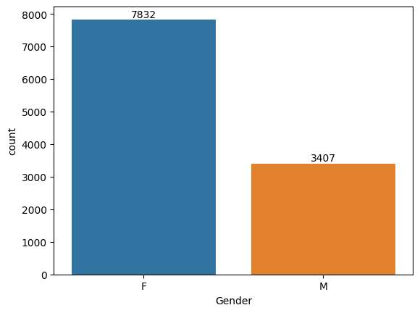
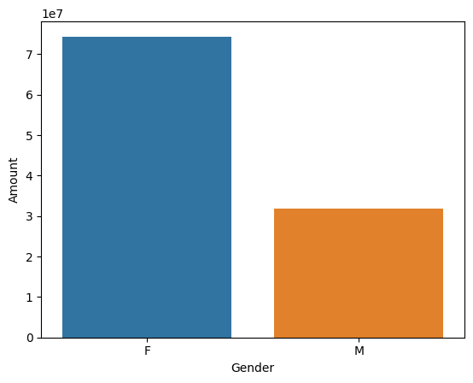
RESULTS
#plotting a bar chart for Gender and it's count
# plotting a bar chart for gender vs total amount
From above graphs we can see that most of the buyers are females and even the purchasing power of females are greater than men

Slide 9
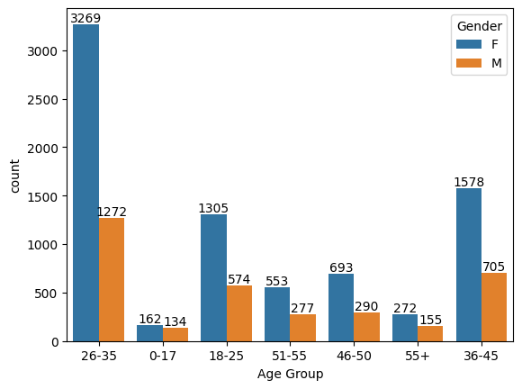
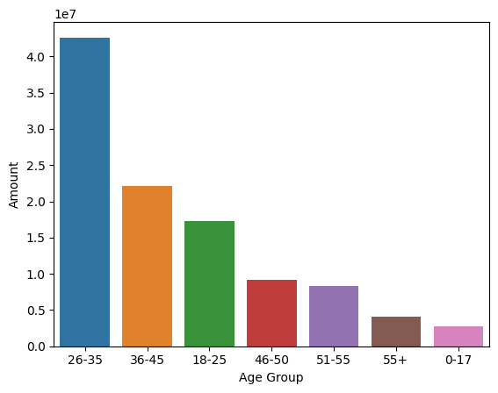
#plotting Age gap between male and femlae
#plotting Total Amount vs Age Group
From above graphs we can see that most of the buyers are of age group between 26-35 yrs female

Slide 10
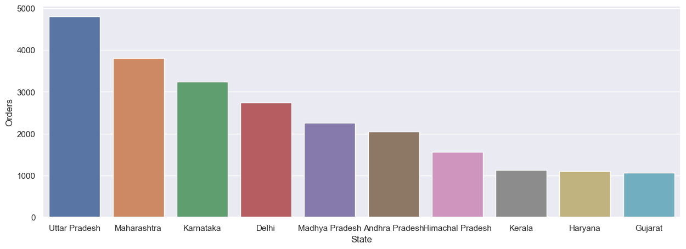
#plotting total number of orders from top 10 states

Slide 11
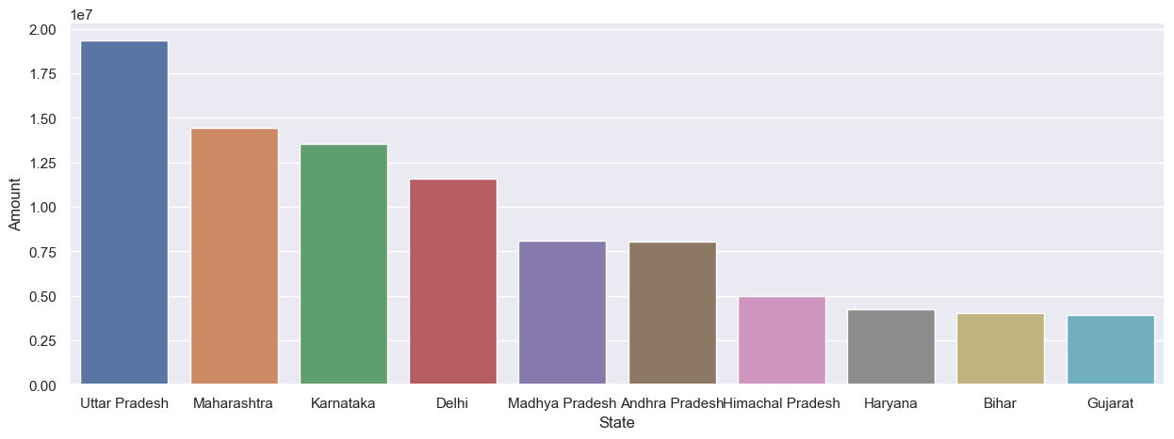
#plotting total amount/sales from top 10 states
From above graphs we can see that most of the orders & total sales/amount are from Uttar Pradesh, Maharashtra and Karnataka respectively

Slide 12
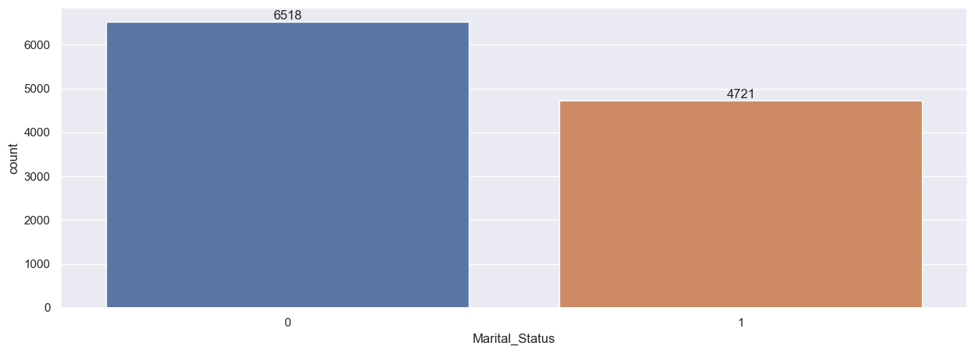
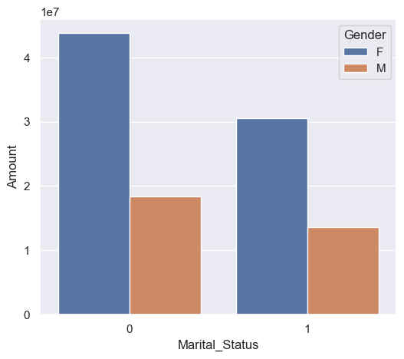
#plotting marital status
# plotting amountspend by marital gender
From above graphs we can see that most of the buyers are married (women) and they have high purchasing power

Slide 13
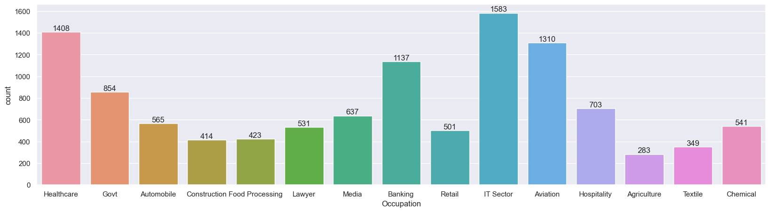
#plotting occupation

Slide 14
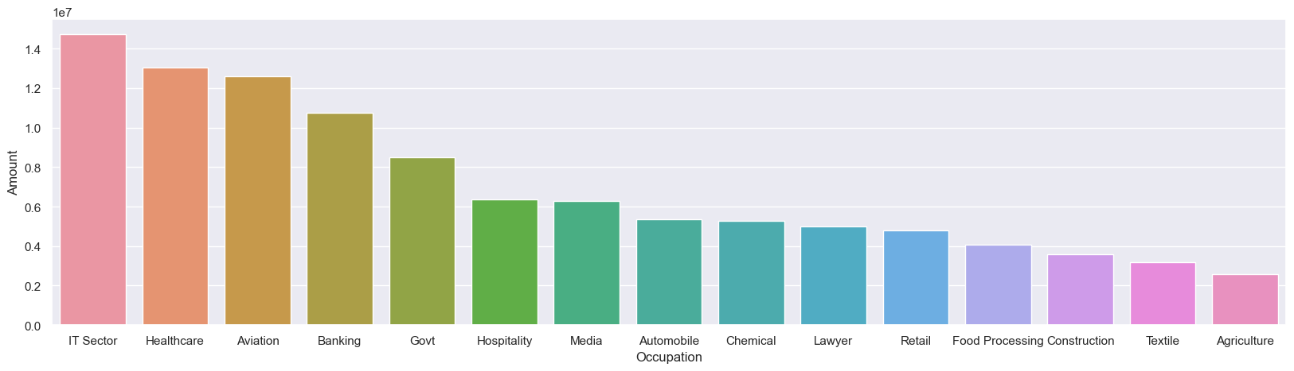
#plotting amountspend by occupation
From above graphs we can see that most of the buyers are working in IT, Healthcare and Aviation sector

Slide 15
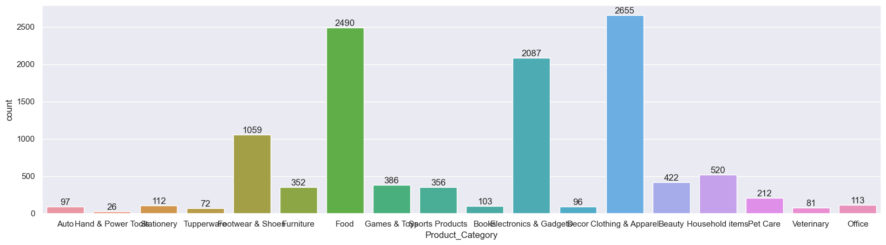
#plotting product category

Slide 16
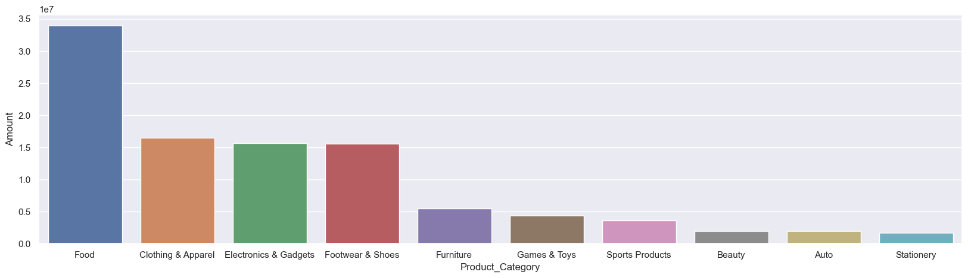
#plotting amountspend on product category
From above graphs we can see that most of the sold products are from Food, Clothing and Electronics category

Slide 17
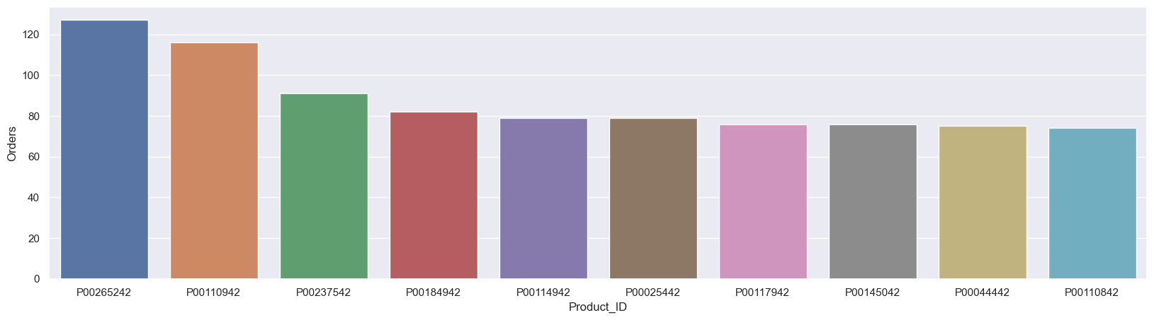
#plotting orders vs productID

Slide 18
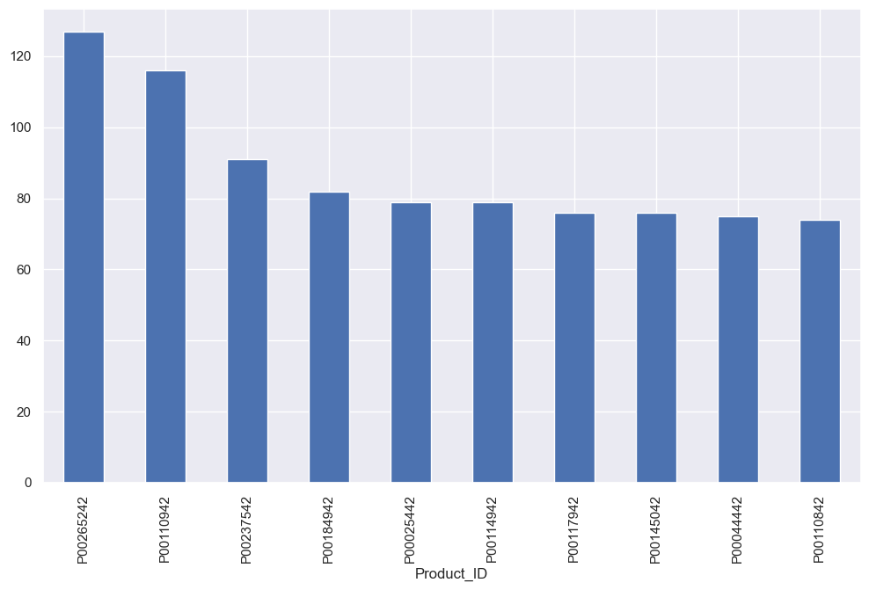
#plotting top 10 most sold products (same thing as above)
Conclusion : Married women age group 26-35 yrs from UP, Maharastra and Karnataka working in IT, Healthcare and Aviation are more likely to buy products from Food, Clothing and Electronics category

Slide 19
CONCLUSION
Analyzing Deepawali sales data using Python provides businesses with powerful tools to enhance customer experience and boost sales. By leveraging data collection, preprocessing, trend analysis, customer segmentation, product performance evaluation, sentiment analysis, and predictive modeling, businesses can make informed decisions that drive higher sales and profitability. This project not only benefits businesses during the Diwali season but also establishes a robust framework for future data-driven initiatives. For beginners, this project offers valuable hands-on experience in applying Python for data science, bridging the gap between theoretical learning and real-world application.

